Slide 1

INTRODUCTION TO MACHINE LEARNING AND AI
DSML

Slide 2


WHAT IS ARTIFICIAL INTELIGENCE (AI)?
A series of IFs
Replication of the Human Brain
Computer with a lot of information
Decision Making Machine
Simulation of Human Inteligence without the emotion factor
Data Squad | Intro to AI

Slide 3
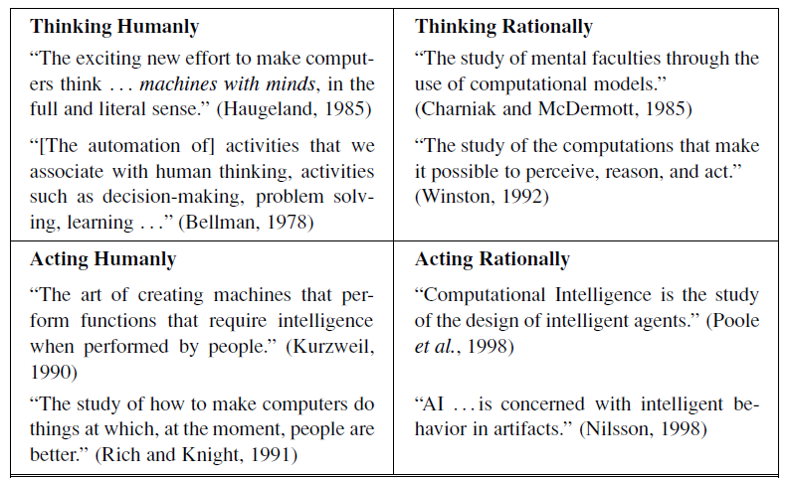
WHAT IS ARTIFICIAL INTELIGENCE (AI)?
Data Squad | Intro to AI

Slide 4
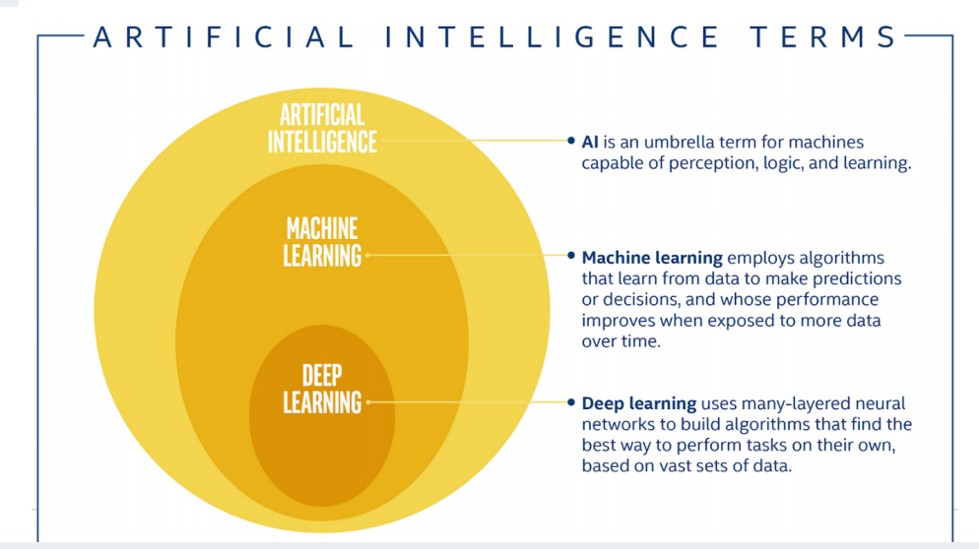
SOME DEFINITIONS
Data Squad | Intro to AI

Slide 5
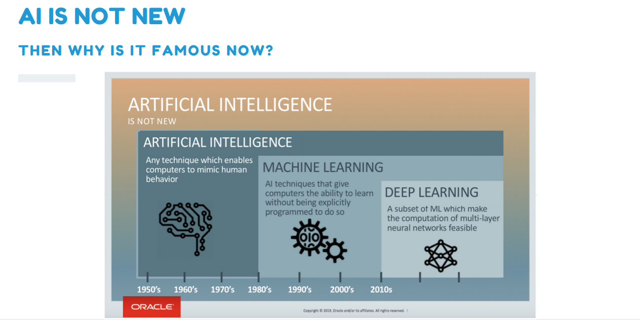
AI IS NOT NEW
THEN WHY IS IT FAMOUS NOW?
Data Squad | Intro to AI

Slide 6
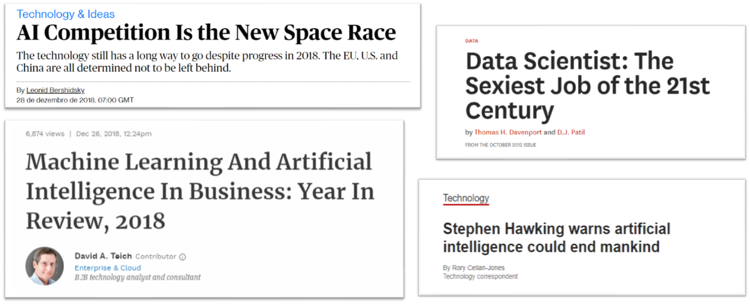
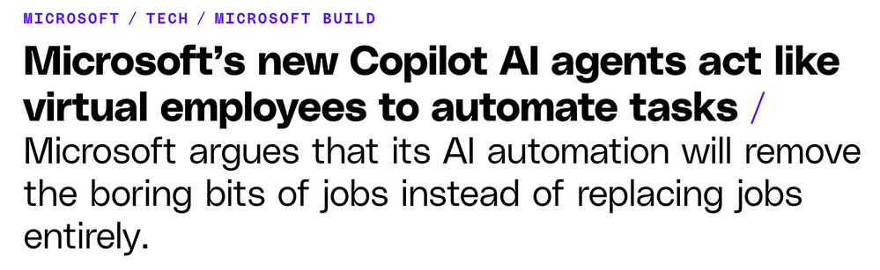
HOT TOPIC IN OUR SOCIETY
Data Squad | Intro to AI

Slide 7
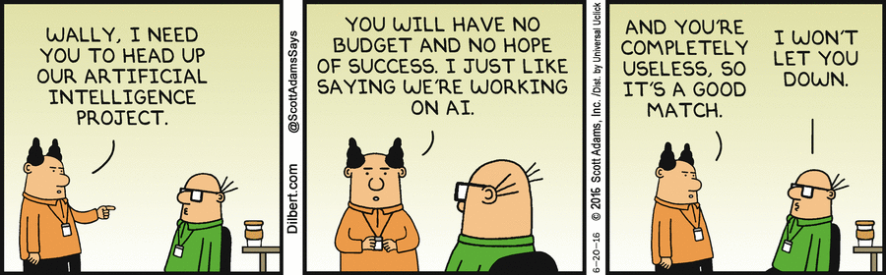
HOT TOPIC IN OUR SOCIETY
Data Squad | Intro to AI

Slide 8
AI IS NOT NEW
THEN WHY IS IT FAMOUS NOW?
Above everything... computational power
"Finally" we are able to properly do AI
Data Squad | Intro to AI

Slide 9
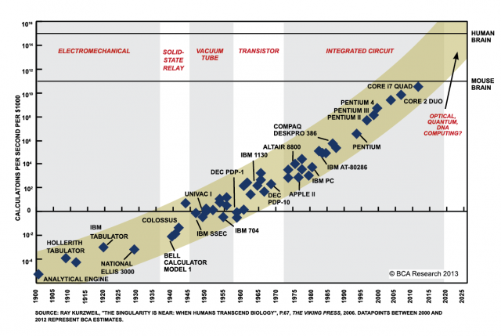
AI IS NOT NEW
EN WHY IS IT FAMOUS NOW?
Data Squad | Intro to AI

Slide 10
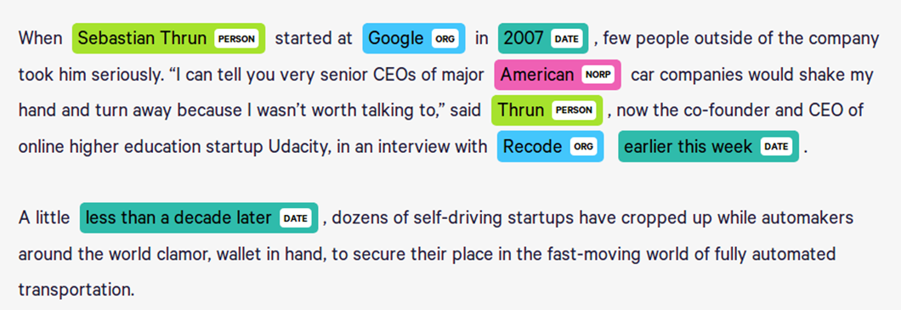
WHAT TYPE OF APPLICATIONS CAN BE SOLVED WITH AI?
Named Entity Recognition
Use Case: Know-Your-Client Teams / Reading Contracts
Whenever there is a new client/contract, thousands of pages
must be read and validated for compliance purposes,
usually only to identify potential issues/threaths
Data Squad | Intro to AI

Slide 11
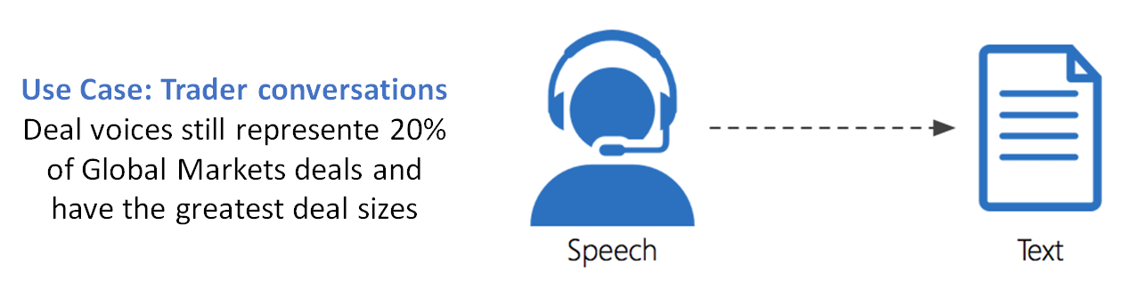
WHAT TYPE OF APPLICATIONS CAN BE SOLVED WITH AI?
Speech To Text
+ use cases: You can imagine others...
Data Squad | Intro to AI

Slide 12
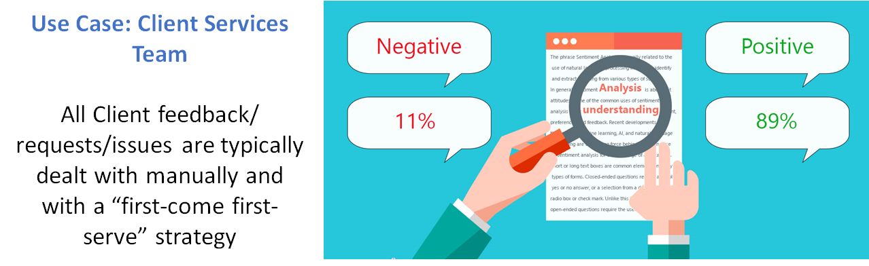
WHAT TYPE OF APPLICATIONS CAN BE SOLVED WITH AI?
Sentiment Analysis
Data Squad | Intro to AI

Slide 13
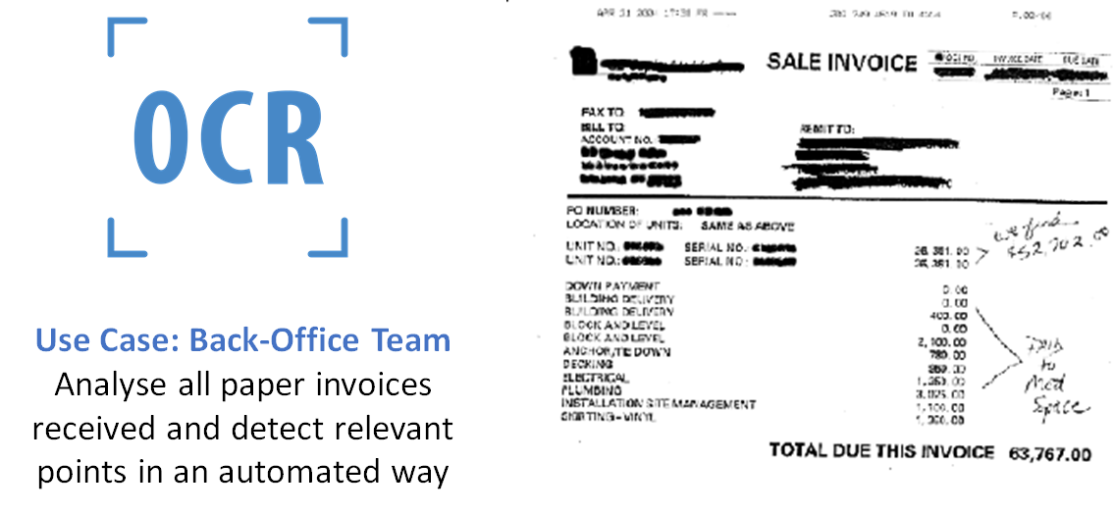
WHAT TYPE OF APPLICATIONS CAN BE SOLVED WITH AI?
(OCR ) Optical Character Recognition
Data Squad | Intro to AI

Slide 14

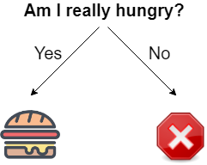
WHAT IS A DECISION?
Data Squad | Intro to AI

Slide 15

HARD CODED RULES
If Else Statements to perform decisions based on conditions defined by our understanding of the problem
DISADVANTAGES:
Has the disadvantage that clearly we cannot code all possible cases
We might be choosing the wrong rules
Example: Hardcoding words to build a Spam Email Filter
Data Squad | Intro to AI

Slide 16

MACHINE LEARNING: WHAT IS IT?
In Machine Learning the objective is to make a prediction Based on information, like in the previous example
BUT
The tree presented before is created in a learning process based on all the information available and on historical data points
Data Squad | Intro to AI

Slide 17

MAKING DECISIONS IN MACHINE LEARNING
There has to be a set of options available - big handycap from the machines
There is usually some uncertainty associated with the decision made
One decision can then affect the subsequent decisions you take
Data Squad | Intro to AI

Slide 18
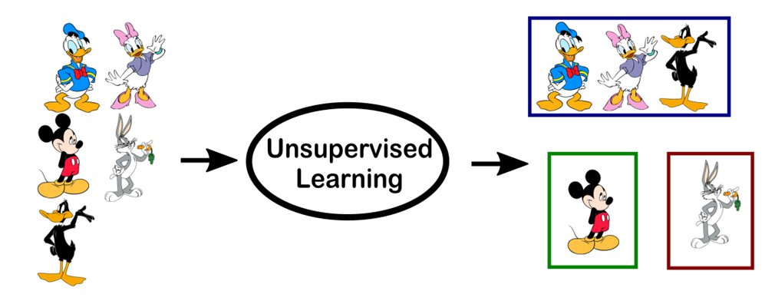





WHAT TYPE OF APPLICATIONS CAN BE SOLVED WITH AI?
Disney or WB?
Data Squad | Intro to AI

Slide 19

WHAT TYPE OF APPLICATIONS CAN BE SOLVED WITH AI?
Disney or WB?
Data Squad | Intro to AI

Slide 20

MACHINE LEARNING: SUPERVISED VS UNSUPERVISED
Supervised ML problem:
[...] Machine Learning task of learning a function that maps an input to an output based on example input-output pairs.[1]
Unsupervised learning problem:
[...] a type of algorithm that learns patterns from untagged data.
[1] Stuart J. Russell, Peter Norvig (2010) Artificial Intelligence: A Modern Approach, Third Edition, Prentice Hall ISBN 9780136042594.
Data Squad | Intro to AI

Slide 21

LEARNING MACHINE OF TYPESDIFFERENT
Supervised: The training data includes the outcome we want to know about.
Unsupervised: The training data does NOT include the outcome we want to know about
Reinforcement: The computer learns through trial and error
Data Squad | Intro to AI

Slide 22
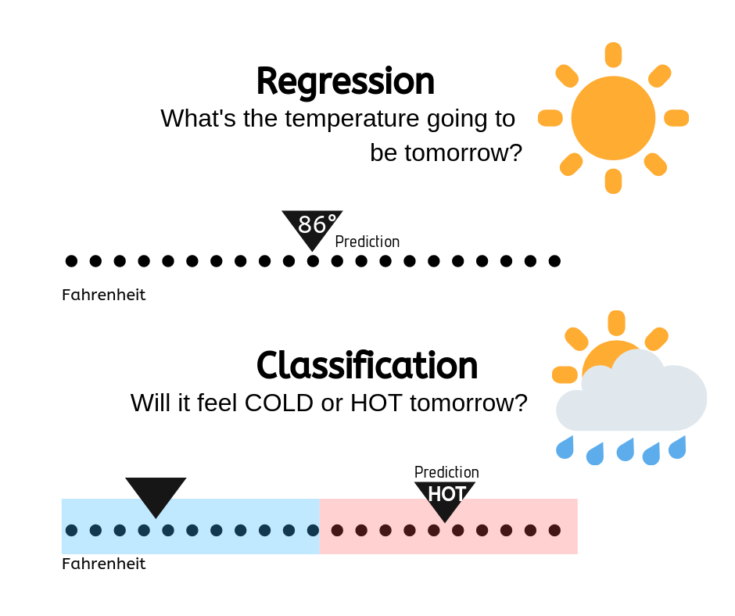
MACHINE LEARNING: TYPES OF SUPERVISED PROBLEMS
In Machine Learning a particular problem can either be a Classification or Regression problem.
The difference is in the type of variable we are trying to predict
Continuous/Numerical : Regression Problem
Categorical: Classification Problem
Data Squad | Intro to AI

Slide 23


SUPERVISED LEARNING
WHAT TO DO
Get Data
(after ETL)
Explore &
Clean data
Question
Select &
Train
model
RESULTS
Data Squad | Intro to AI

Slide 24
MACHINE LEARNING EXAMPLE: DISNEY VS WB
Disney or WB?
Data Squad | Intro to AI

Slide 25
MACHINE LEARNING EXAMPLE: DISNEY VS WB
Disney or WB?
Data Squad | Intro to AI

Slide 26
MACHINE LEARNING: UNSUPERVISED
Data Squad | Intro to AI

Slide 27
MACHINE LEARNING: UNSUPERVISED
Data Squad | Intro to AI

Slide 28

DATA
Historical Data: data collected over some period of time.
Ex: Incomes and demographic qualities, zip-code, weather.
Auto-Labelling Data: dataset built by using a tool or process.
Ex: If we want a dataset of labeled animals, we can go to google images.
Manual-Labelled Data: data labelled by a human analyst that provides the human class. This type of labelling is easier with crowd-sourcing.
Ex: Detecting extremist language in different languages
Data Squad | Intro to AI

Slide 29

WHY PYTHON?
Scikit Learn
https://scikit-learn.org/stable/
Data Squad | Intro to AI

Slide 30

WHY PYTHON?
Scikit Learn
TensorFlow
Data Squad | Intro to AI

Slide 31

WHY PYTHON?
Scikit Learn
TensorFlow
PyTorch
Data Squad | Intro to AI

Slide 32




ANY QUESTIONS ?

Slide 33
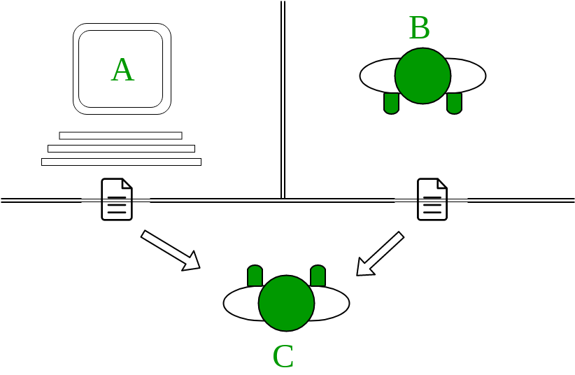
TURING TEST
Data Squad | Intro to AI

Slide 34
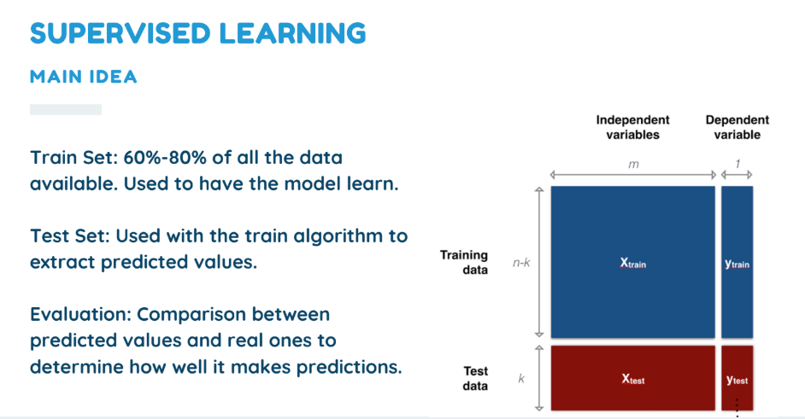
SUPERVISED LEARNING
MAIN IDEA
Train Set: 60%-80% of all the data available. Used to have the model learn.
Test Set: Used with the train algorithm to extract predicted values.
Evaluation: Comparison between predicted values and real ones to determine how well it makes predictions.
Data Squad | Intro to AI

Slide 35
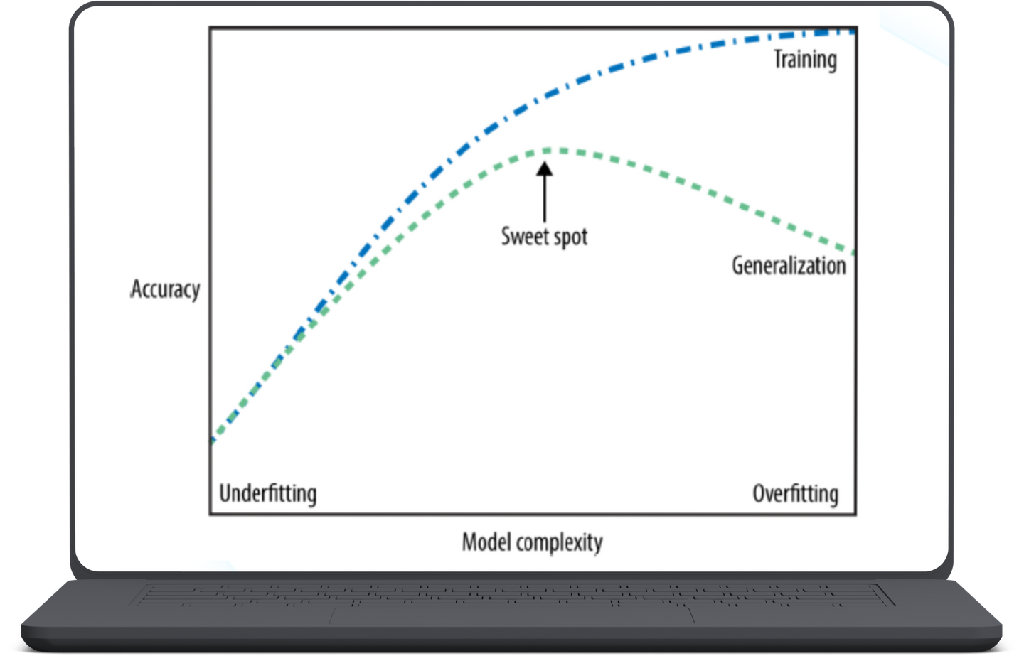
GENERALIZATION, UNDERFITTING & OVERFITTING
Data Squad | Intro to AI

